Slide 1
Planner Prerequisites and Caveats
Prerequisites
Current Caveats
History
Zerto version 7.0u1 or higher
ZVM must have internet access and 443 open to https://zerto-mobile-data.zerto.com
A Zerto license (any)
User must have myzerto.com access for the Analytics
Assumes 50% compression ratio and 24 hours of journal history
AWS and Hyper-V support is not available at this time
Journal length is selectable for the previous 30 days, assuming that the ZVM has been running for that amount of time
Note: For prospects that refuse to install Zerto's ZVM, the standalone zPlanner is still available upon request with your Account team

Slide 2
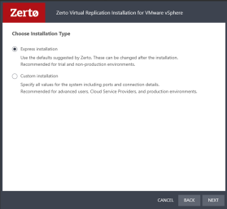
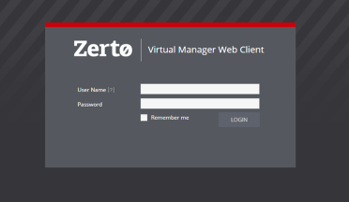
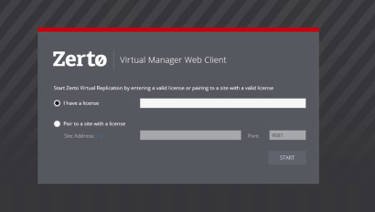
Planner Deployment – Sizing for a prospect
Download ZVM version 7.0U1 or above from MyZerto
Install ZVM
Express installation, no specific setup is required.
VC admin credentials need to be provided.
Online services should be left enabled (default).
Setup ZVM
Log in to ZVM and input your Zerto license (any).
Within ZVM site settings, opt-in to Zerto Analytics
Log in to Zerto Analytics and navigate to the "Planning" tab.
Click VM selection to start using the resource planner
Select the desired Source Site.
Out of the monitored VMs list, pick the VMs to be included in the planning report.
Specify the platform type of the target recovery site
Optionally select a date range for historical data baseline (default=1 week)
View the planning report in Zerto Analytics
Notes:
*Any License can mean a Trial license on the CSP account

